Slide 1

Wireless Network Proposal
Anushka Kadam (069), Uday Bharadiya (102), Utkarsh Singh (090), Yash Sinha(077)

Slide 2
Content List
Problem Statement
Requirement and Analysis
Hardware
Software
Threats
Network Topology Diagram
Result and analysis
Implementation on Kali Linux
Conclusion

Slide 3
Problem Statement
The task is to create a wireless network proposal at a campus. The campus has 3 departments: management, research and finance.
Each department has approximately 30 users. ADSL internet connection is available in the campus, which needs to be shared by all the users in the different departments. Wireless access to the network should be available using access points installed at strategic locations.

Slide 4
Problem Statement (Cont.)
Users should also be able to access the network through computers using LAN connectivity. Files servers should be setup on the network for users in the departments to share and transfer files. Guest users should be able to connect to the internet through the wireless access points, without any authentication. Users in each department should have a common password, which should be used for gaining access to the network through the wireless access points. The guest users should not have access to the file server installed on the network. Dynamic IP addressing system should be available from a single DHCP server to allocate IP address to all departments users and guests. Users should be able to connect to the appropriate departments, highlighted through appropriate names on the access point. Appropriate equipment for internet sharing should be made available.

Slide 5
Requirement and Analysis
Hardware Requirements
Processor : 2.4 GHz Clock Speed
RAM : 1 GB
Hard Disk : 500 MB (Minimum free space)
Software Requirements
Operating System : Windows 7 , Kali Linux
Back End : MySql
Special Tools : Wireshark,Metasploitable

Slide 6
Hardware
Routers: A router is a networking device that forwards data packets between computer networks. Routers perform the traffic directing functions on the Internet.
AR9271: A wireless adapter for Monitor mode and Packet Sniffing.

Slide 7
Software
Cisco Packet Tracer (V8.0.0)- Cisco Packet Tracer as the name suggests, is a tool built by Cisco. This tool provides a network simulation to practice simple and complex networks. The main purpose of Cisco Packet Tracer is to help students learn the principles of networking with hands-on experience as well as develop Cisco technology specific skills. Since the protocols are implemented in software only method, this tool cannot replace the hardware Routers or Switches. Interestingly, this tool does not only include Cisco products but also many ore networking devices.
VMWare- It enables users to create and run VMs directly on a single Windows or Linux desktop or laptop. Those VMs run simultaneously with the physical machine. Each VM runs its own OS such as Windows or Linux.
DHCP Server- A DHCP Server is a network server that automatically provides and assigns IP addresses, default gateways and other network parameters to client devices. It relies on the standard protocol known as Dynamic Host Configuration Protocol or DHCP to respond to broadcast queries by clients.

Slide 8
Threats
Since the user in each department has common password , there is a possibility of breaching the security and getting the key. If the key gets cracked by the hackers they’ll have access to every department
And now talking about the guest , the guests gets connected to the devices in the departments without any authentication. The problem that arises here is that people outside the campus can also have access because there is no authentication and the password is common.

Slide 9
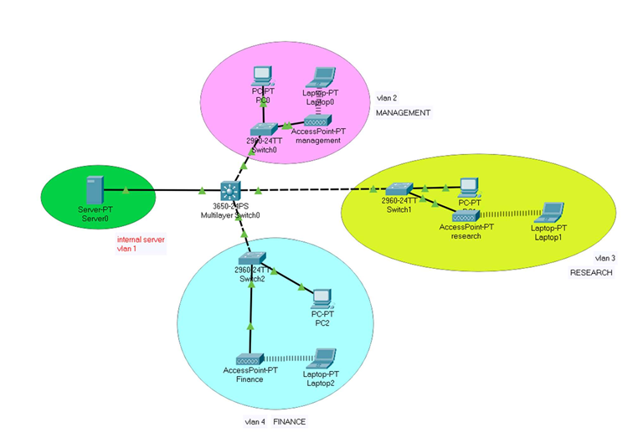
NETWORK TOPOLOGY DIAGRAM

Slide 10
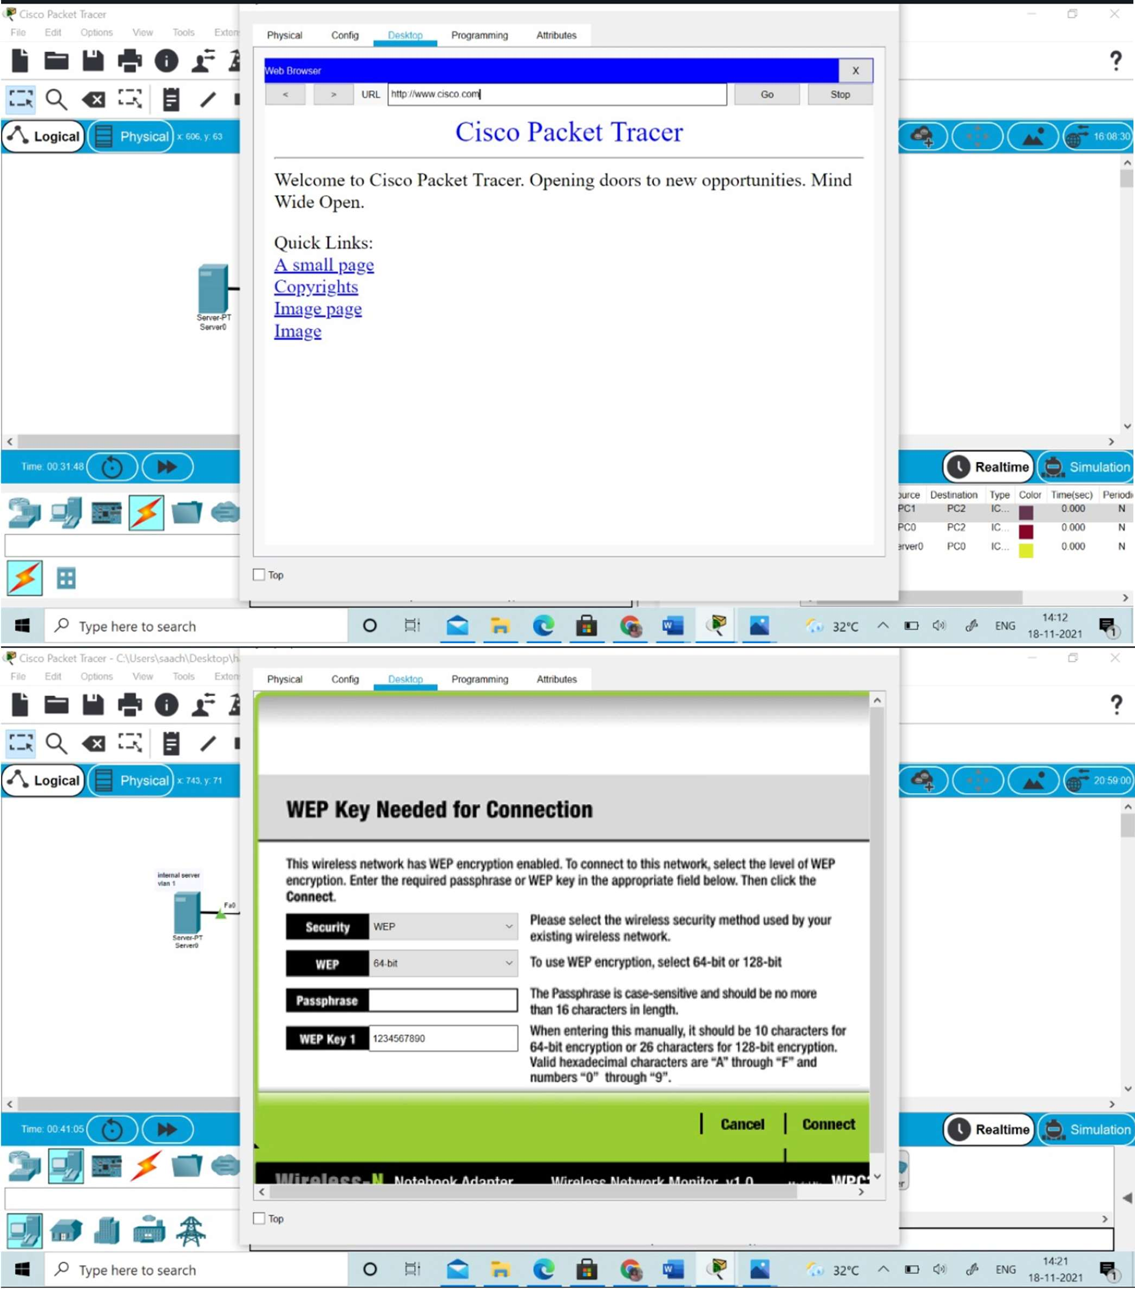
RESULT AND ANALYSIS

Slide 11
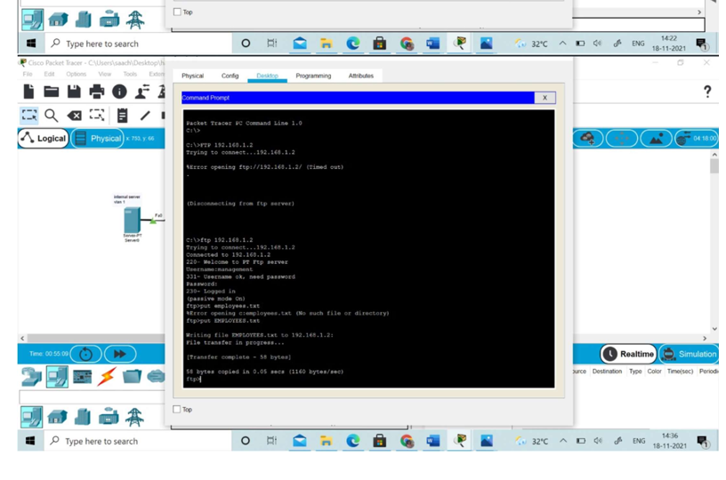

Slide 12
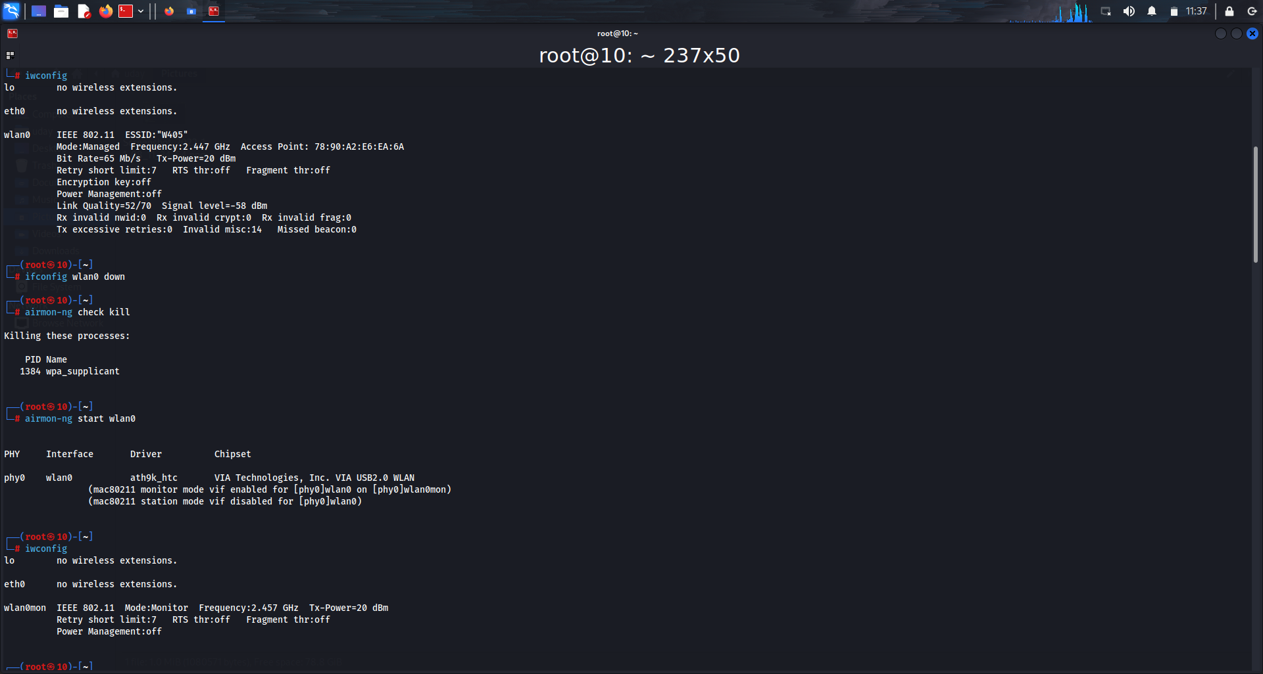
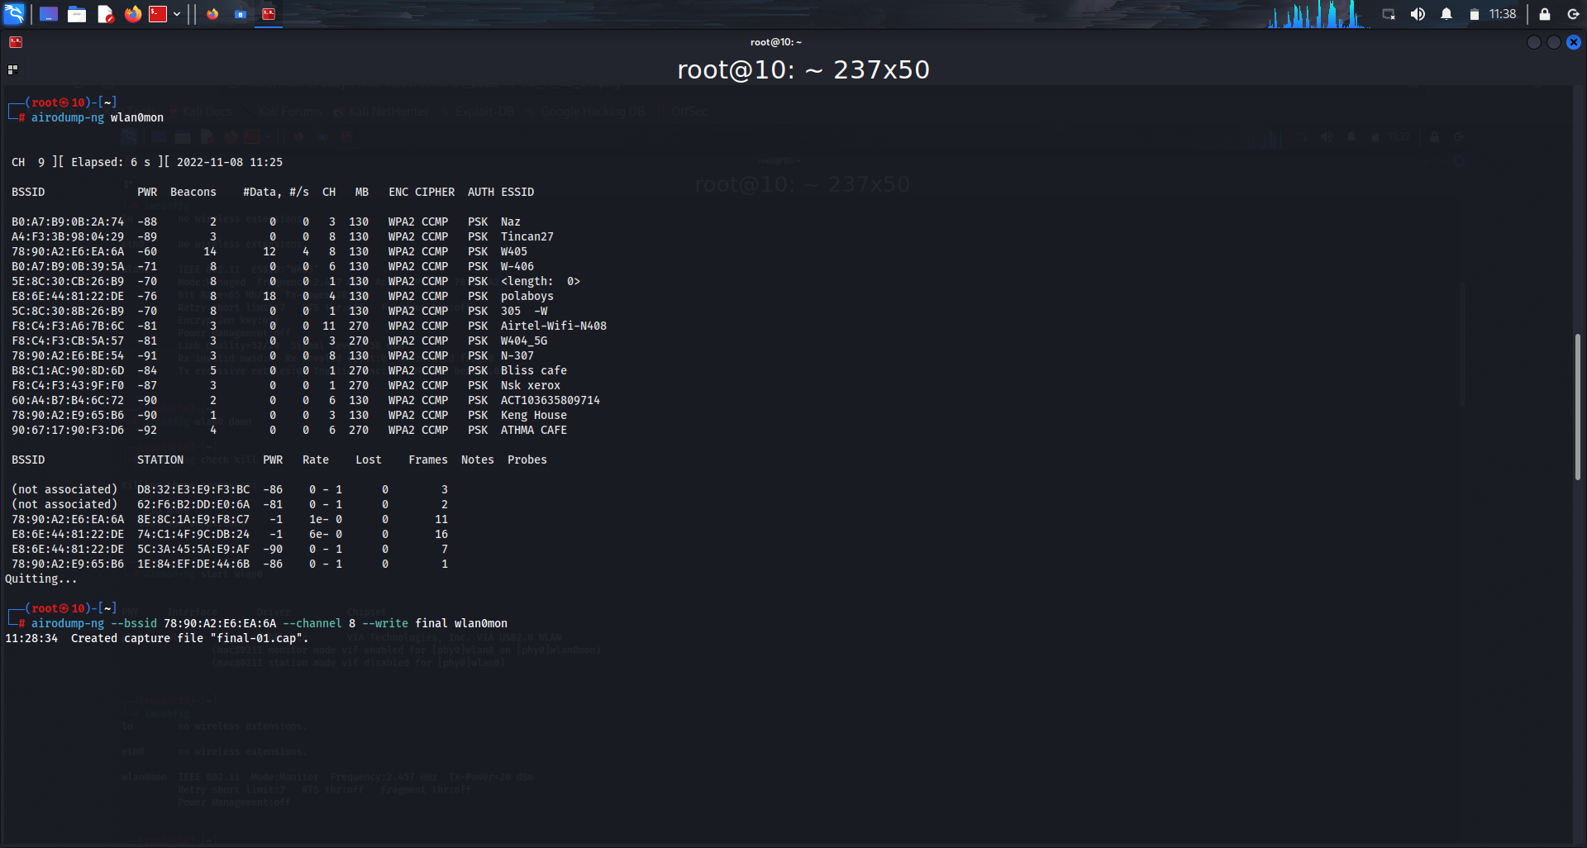
IMPLEMENTATION ON KALI LINUX

Slide 13
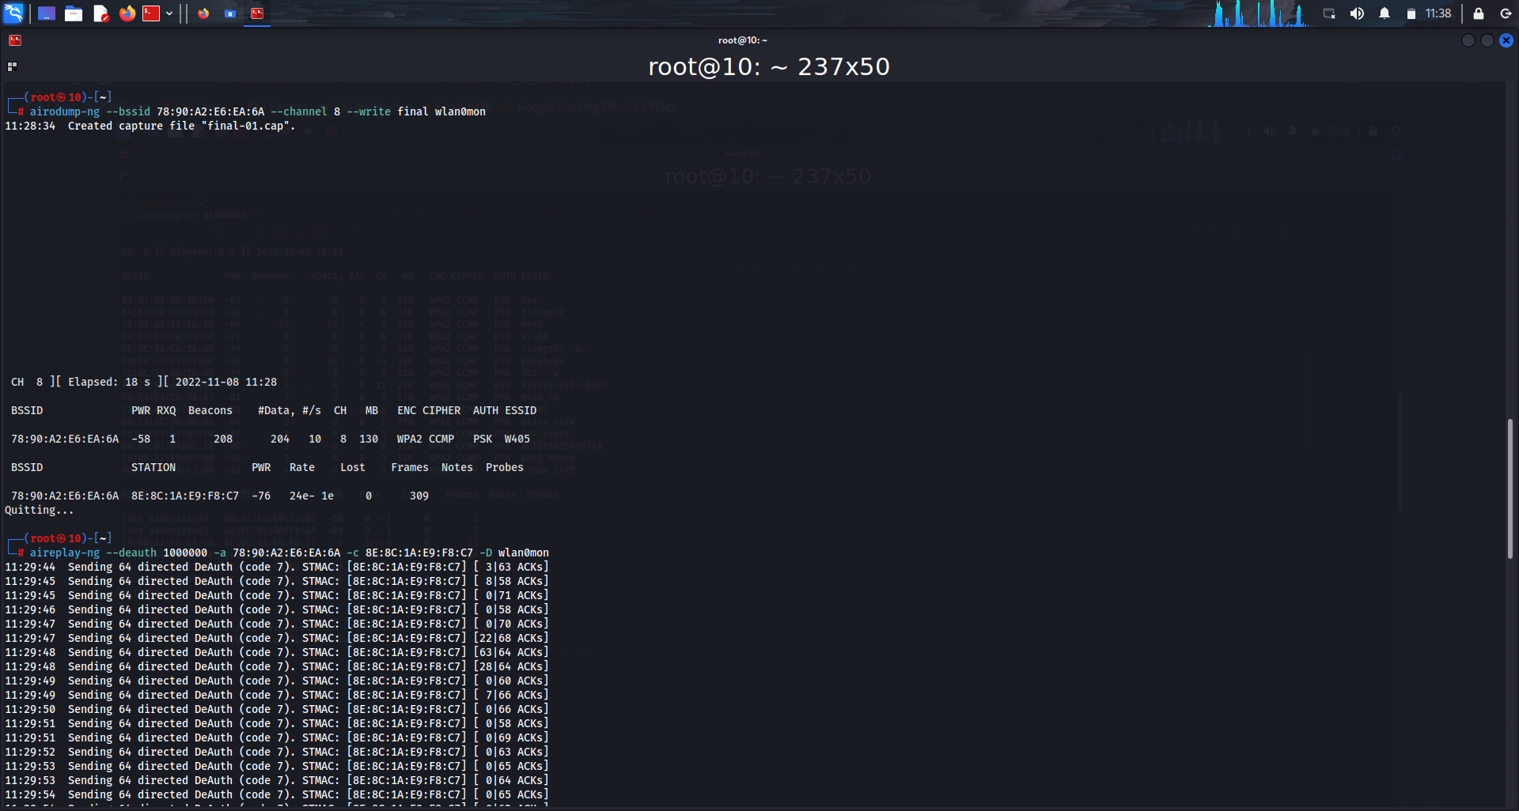
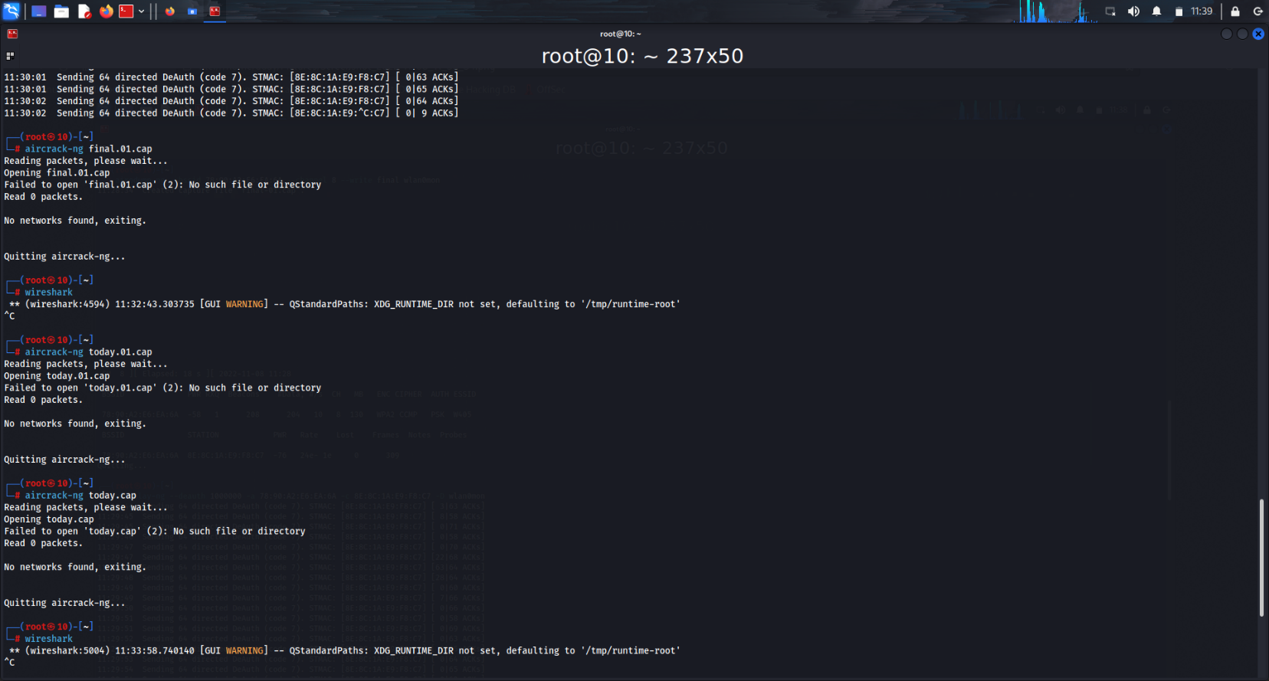

Slide 14
Conclusion
With the growth of Information Technology in every sector and the explosion of medical IOT devices, the design of a network of any university has become a very essential factor.
The universities need to have a reliable, secure and scalable network design in order to keep the students' information, faculty’s research work safe, convenient communication between various departments, etc. as well as keep it ready for any new IOT l equipment that may be introduced in the future. Hence we can strive to make the proposed architecture more viable for future needs.
The hierarchical model of networking best suits our needs along with providing additional features like easy maintenance, high security, simplified troubleshooting and effective performance.

